Slide 1
Psychology and Personal Finance
Investment Mistakes

Slide 2
Overview
Investment Mistakes
  Active management
  Excessive extrapolation
  Trading too much
  Disposition effect
  Naïve diversification
  Familiarity bias
  Myopic loss aversion
  Regret aversion
  Money illusion
  Neglecting Fees
  Taxes
  Housing
  Human capital

Slide 3
Active Management

Slide 4
Investing In Mutual Funds
$4 trillion in domestic equity mutual funds
90% of funds actively managed
Only 8% of funds managed to outperform the S&P 500 over a 10 year period
Sources: Avramov, et al (2006), Wermers (2000), http://www.efmoody.com/investments/pastperformance.html

Slide 5
Beat The Market
With an audience of 1,000 portfolio managers, the likelihood of at least one manager “accidently” outperforming the market eight years in a row is …
98%

Slide 6
What We’ve Learned (So Far)
Investment Mistakes
  Active management

Slide 7
Excessive Extrapolation

Slide 8

Mr. R’s Wild Ride
Borrowed $50,000,000
To Purchase CSCO
100% CSCO:
$100,000,000
CSCO IPO:
$595,007
MSFT IPO:
$12,736

Slide 9
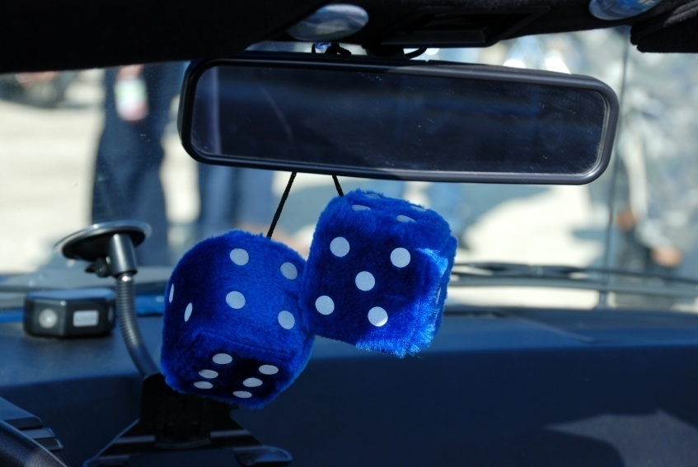
Neither Past Performance Nor the Back Mirror Will Predict The Future

Slide 10
What We’ve Learned (So Far)
Investment Mistakes
  Active management
  Excessive extrapolation

Slide 11
Trading Too Much

Slide 12
Investors Seem To Trade A Lot
Individual investors have an annual turnover of 75% in their brokerage accounts.
Similar turnover data are observed for mutual funds and the total NYSE.
Are investors informed or just overconfident?
Sources: Barber and Odean (2002); Cahart (1997)

Slide 13
Trading Can Be Hazardous To Your Wealth
Source: Barber and Odean (2000)

Slide 14
Men Trade (And Lose) More Than Women
Source: Barber and Odean (2001)

Slide 15


Those Who Speed Also Trade More
Source: Grinblatt and Keloharju (2007)

Slide 16
What We’ve Learned (So Far)
Investment Mistakes
  Active management
  Excessive extrapolation
  Trading too much

Slide 17
Disposition Effect

Slide 18
Question:
You bought 1,000 shares of stock A ($50/share) and 1,000 shares of stock B ($100 /share)
After a few periods, your stocks are now worth:
Stock A: $50k → $75k
Stock B: $100k → $75k
You now need $75k to buy a house –
what would you sell?

Slide 19
Disposition Effect
For most of the year, on average, a stock that is up in value is 60% more likely to be sold than one that is down in value
Source: Odean (1998)

Slide 20
What We’ve Learned (So Far)
Investment Mistakes
  Active management
  Excessive extrapolation
  Trading too much
  Disposition effect

Slide 21
Naïve Diversification

Slide 22

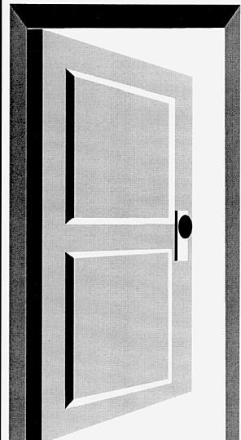


Diversification Experiment With Halloween Trick-Or-Treaters
Case 1: Pick 1 Candy
From Each of 2 Houses
Case 2: Pick 2 Candies
From 1 House
48% Diversified
100% Diversified
Source: Loewenstein, et al (1995)

Slide 23
Diversification
TWA Pilots offered:
5 stock funds
1 fixed income fund
UC Employees offered:
1 stock fund
4 fixed income funds
Source: Benartzi and Thaler (2001)

Slide 24
What We’ve Learned (So Far)
Investment Mistakes
  Active management
  Excessive extrapolation
  Trading too much
  Disposition effect
  Naïve diversification

Slide 25
Familiarity / Home Bias

Slide 26
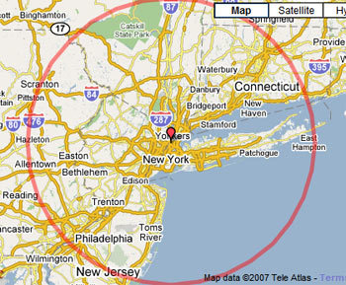
Familiarity Bias
A typical money manager’s portfolio consists of firms that are located 100 miles closer to the manager’s office than the average US firm
Source: Coval, et al (1999)

Slide 27



Home Investment Percentages From Around The World
82%
94%
98%
Source: Howell, et al (1990)

Slide 28
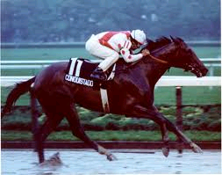
Let’s Go To The Races!
Conquistador Cielo,
winner of the 1982
Belmont Stakes, raced
most of his career on
the East Coast.
East Coast racing fans
knew him well, but West Coast fans didn’t.

Slide 29

Cross Track Betting
Consider cross-track
betting: Bettors can
place a wager at their
local track on a race run elsewhere.
If you could place a bet on Conquistador Cielo before the Belmont, would you pick an East Coast track or a West Coast track?

Slide 30
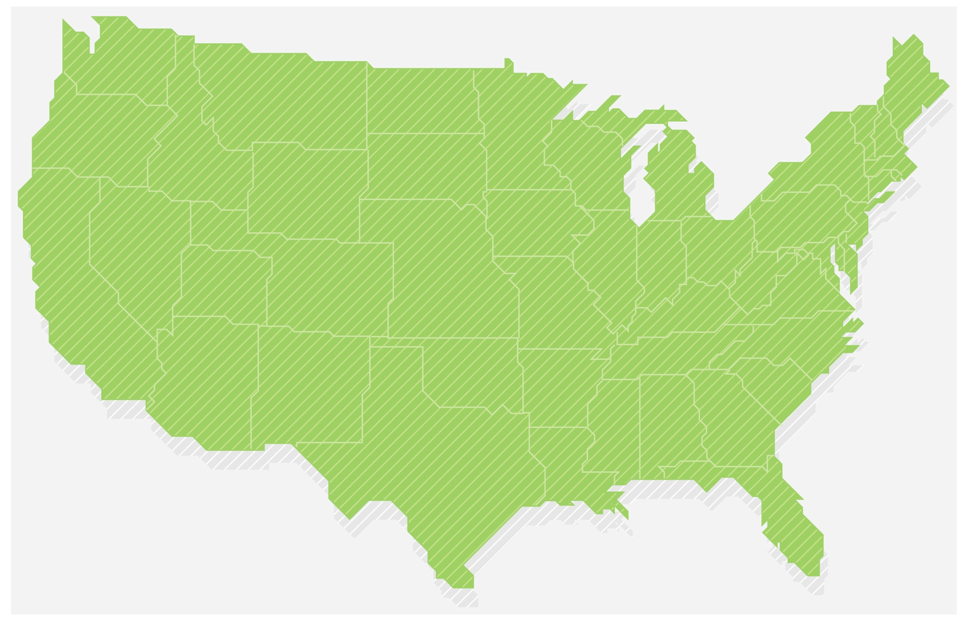
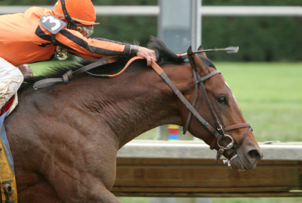
And The Winner Is…
Commodore Downs Race Track
Payout $5.80
Los Alamitos Race Track
Payout $15.40
West Coast bettors earned more on Conquistador Cielo’s win just because fewer people in the area knew him!
Source: Hausch and Ziemba (1990)

Slide 31
What We’ve Learned (So Far)
Investment Mistakes
  Active management
  Excessive extrapolation
  Trading too much
  Disposition effect
  Naïve diversification
  Familiarity bias

Slide 32
Myopic Loss Aversion

Slide 33
Question:
Consider the following bet:
I flip a coin – either you win $200 or you lose $100. Are you willing to play it for real money right now?
Source: Samuelson (1969)

Slide 34
Why Do People Reject The Bet?
Samuelson’s bet is a great investment, since you “invest” $100 and you either lose it or get $300 back
And, there is really no “risk” in losing $100 (other than explaining to your spouse)
Yet, most people reject the bet - Why?

Slide 35
The Bet Is Unattractive To Loss Averse Investors
Losses loom larger than gains
The pain of a loss is twice the pleasure of a gain
We simply hate to lose, even small amounts
Source: Kahneman and Tversky (1979)

Slide 36
Question:
Now, what if we play 2 rounds
of the Samuelson bet?

Slide 37
Playing & Watching Short-Term Losses
First Round | Second Round | Hedonic Experience
+200 | +200
+200 | -100
-100 | +200
-100 | -100
Source: Benartzi and Thaler (1995)

Slide 38
Playing & Watching The Aggregate Outcome
First Round | Second Round | Total | Hedonic Experience
? | ? | +400
? | ? | +100
? | ? | +100
? | ? | -200
Source: Benartzi and Thaler (1995)

Slide 39
Why Do Long Term Investors Hold Bonds?
Source: Benartzi and Thaler (1995)

Slide 40
Answer:
Because investors are loss averse and myopic
They tend to pay too much attention to short-term losses, even when they invest for the long-run
Source: Benartzi and Thaler (1995)

Slide 41
What We’ve Learned (So Far)
Investment Mistakes
  Active management
  Excessive extrapolation
  Trading too much
  Disposition effect
  Naïve diversification
  Familiarity bias
  Myopic loss aversion

Slide 42
Regret Aversion

Slide 43
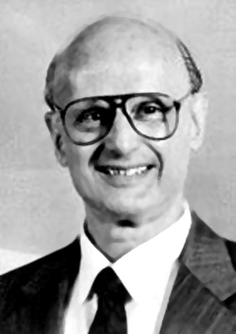
Harry Markowitz
“I should have computed the historical co-variances of the asset classes and drawn an efficient frontier.”
Instead … “I split my contributions fifty-fifty between bonds and equities…
My intention was to minimize my future regret.”
Source: Money (1998)

Slide 44
Money Illusion

Slide 45
Question:
Would you rather purchase a 10 year TIPS (Treasury Inflation-Protected Security) or a 10 year nominal treasury bond?

Slide 46
What We’ve Learned (So Far)
Investment Mistakes
  Active management
  Excessive extrapolation
  Trading too much
  Disposition effect
  Naïve diversification
  Familiarity bias
  Myopic loss aversion
  Regret aversion
  Money illusion

Slide 47
Neglecting Fees

Slide 48
Question:
If you to pay an additional 1% annual fee on your account, how much less would it be worth 30 years down the road?
~ 30%!

Slide 49
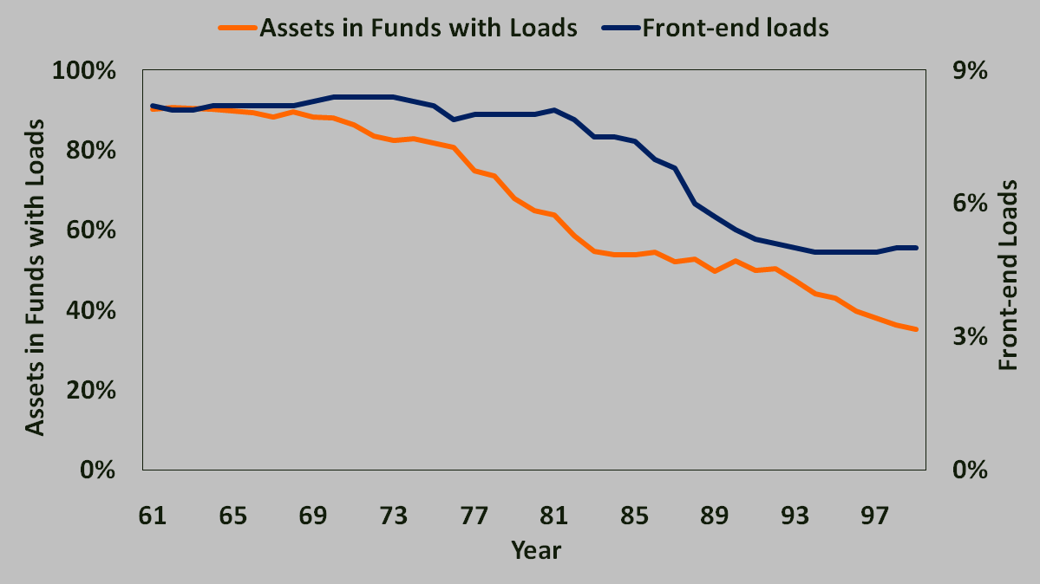
Front-End Loads & The Percentage Of Assets In Funds With Loads
Source: Barber et al (2005)

Slide 50
Fund Flows – Expense Ratio & New Money
Source: Barber et al (2005)

Slide 51
Research On Fees
Less than 20 percent of mutual fund holders could give an estimate of their fees
Only one in five state employees realized the effect of fees
However, investors are sensitive to obvious expenses
Sources: Alexander et al (1998), Benartzi (2008), Barber et al (2005)

Slide 52
What Do Investors Understand About Fees?
Investors are sensitive to front-end load fees from mutual funds…
…but less so to operating expenses
Expenses that remain out of sight are likely to remain out of mind
Source: Barber, et al (2005)

Slide 53
What We’ve Learned (So Far)
Investment Mistakes
  Active management
  Excessive extrapolation
  Trading too much
  Disposition effect
  Naïve diversification
  Familiarity bias
  Myopic loss aversion
  Regret aversion
  Money illusion
  Neglecting Fees

Slide 54
Taxes

Slide 55
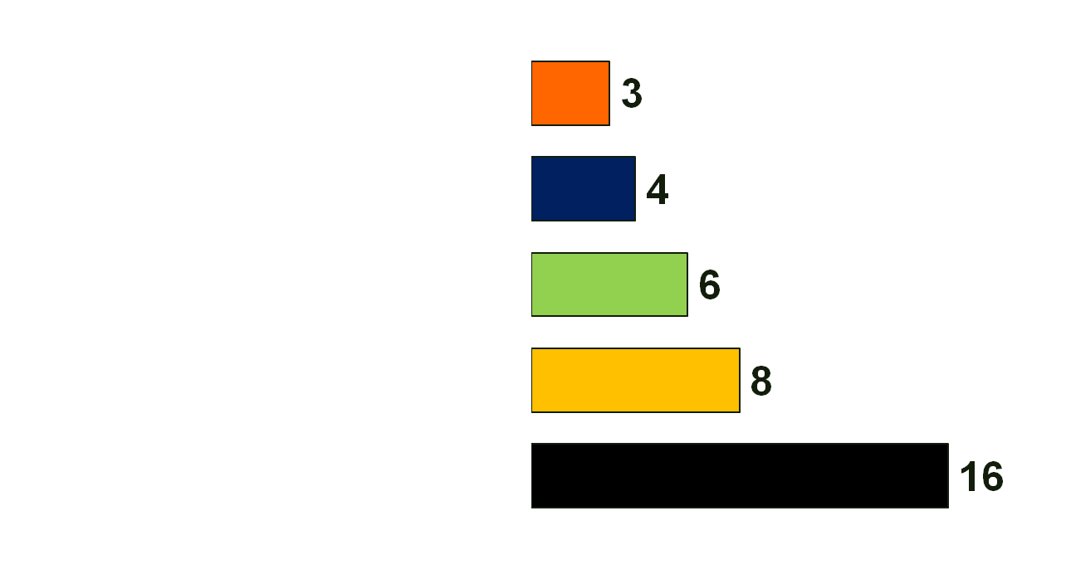
What’s Weird With This Portfolio?
Tax-exempt Bond Funds
Taxable Bond Funds
Money-market Funds
Int’l/Global Funds
U.S. Stock Funds
Source: Wall Street Journal (1997)

Slide 56
What We’ve Learned (So Far)
Investment Mistakes
  Active management
  Excessive extrapolation
  Trading too much
  Disposition effect
  Naïve diversification
  Familiarity bias
  Myopic loss aversion
  Regret aversion
  Money illusion
  Neglecting Fees
  Taxes

Slide 57
Housing

Slide 58
Class Discussion
What factors are there when deciding whether to buy or rent a house?
What are the possible behavioral blind-spots?

Slide 59
Buy Vs. Rent
Buy a $500,000 condo:
+$35,000 interest
+$ 6,000 property tax
+$ 5,000 own maintenance
+$ 3,000 home association
+$ 1,000 insurance
-$15,000 tax deductions
$35,000 per year
Rent for $2,000/mo:
+$24,000 rent
___________________
$24,000 per year
>
To Run the Housing Calculator - Click Here

Slide 60
In 2001, Median Homeowners Had (In $k):
Source: http://goliath.ecnext.com/coms2/gi_0199-5060503/Evaluating-the-risk-of-housing.html#abstract

Slide 61
Median Wealth For Households Age 35 – 44 (In 2008 Dollars)
Source: Baker, et al (2008)

Slide 62
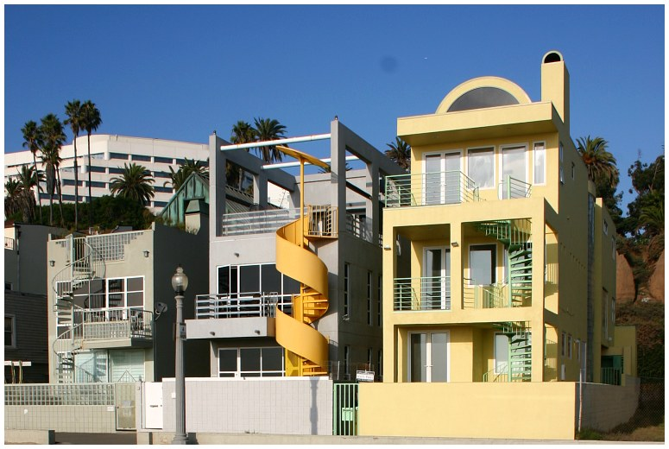

Housing & Emotion

Slide 63
What We’ve Learned
Investment Mistakes
  Active management
  Excessive extrapolation
  Trading too much
  Disposition effect
  Naïve diversification
  Familiarity bias
  Myopic loss aversion
  Regret aversion
  Money illusion
  Neglecting Fees
  Taxes
  Housing

Slide 64
Human Capital

Slide 65
Human Influence
When choosing a college major:
Students are more likely to choose a major when peers have made the same choice
Following peers diverts students from majors where they have an ability advantage
Over time, these students were found to have had lower grades, lower starting salaries, and lower job satisfaction
Source: De Giorgi, et al (2010)

Slide 66
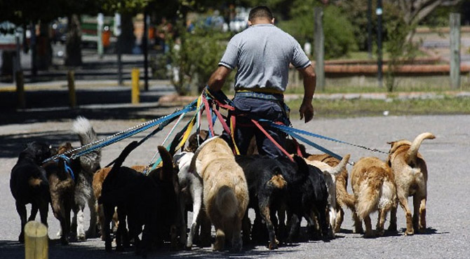
The Dog Walker

Slide 67

And …

Slide 68
What We’ve Learned
Investment Mistakes
  Active management
  Excessive extrapolation
  Trading too much
  Disposition effect
  Naïve diversification
  Familiarity bias
  Myopic loss aversion
  Regret aversion
  Money illusion
  Neglecting Fees
  Taxes
  Housing
  Human capital

