Slide 1
Psychology and Personal Finance
Prospect Theory

Slide 2
First, a Video
What is this class about?
http://befi.allianzgi.com/en/Topics/Pages/save-more-tomorrow.aspx#

Slide 3
Course Overview
Prospect Theory
Heuristics and Biases
Sub-Optimal Spending
Investment Mistakes
Retirement
Money and Happiness
Behavioral Finance in Action
Team Presentations

Slide 4
Overview: Today’s Lecture
Prospect Theory:
How do we evaluate risky prospects?

Slide 5
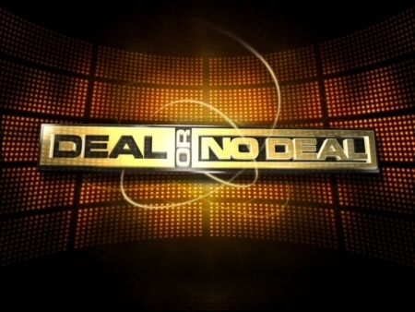
First, Let’s Play A Game…

Slide 6
Let’s Review A Real Episode
Case – “Frank”, Netherlands, 1/1/05

Slide 7
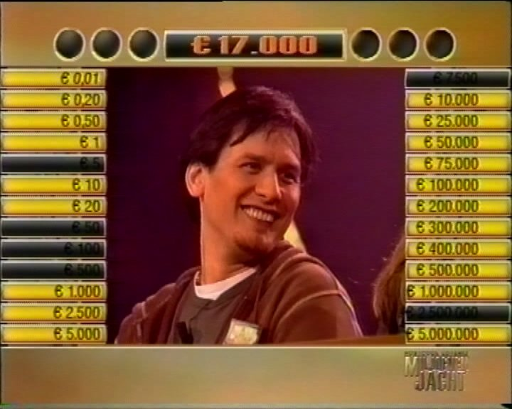
NO DEAL!
What would YOU do?
Mean = 383,427
Source: Post, et. al (2008)

Slide 8
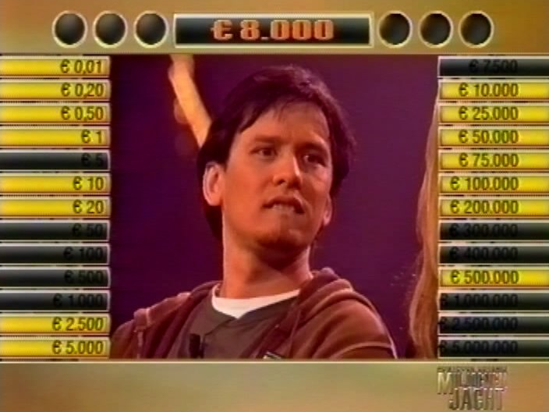
NO DEAL!
What would YOU do?
Mean = 64,502
Source: Post, et. al (2008)

Slide 9
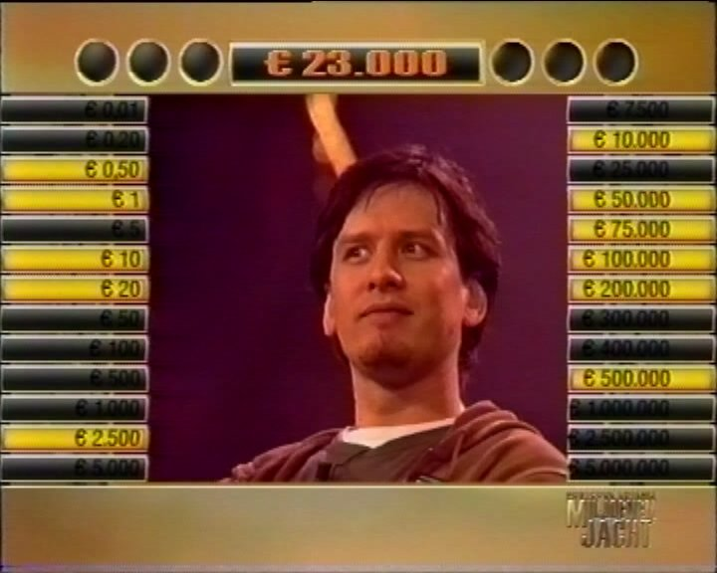
NO DEAL!
What would YOU do?
Mean = 85,230
Source: Post, et. al (2008)

Slide 10
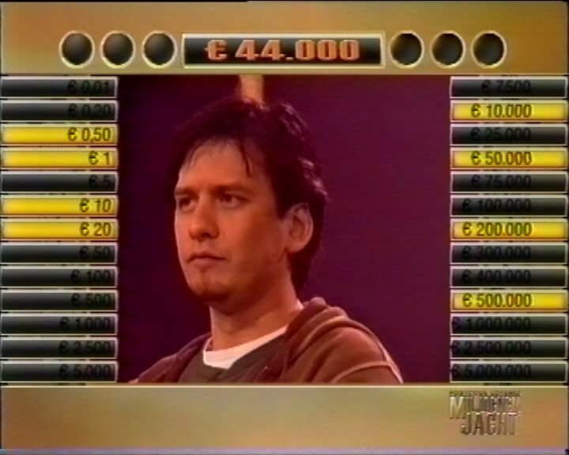
NO DEAL!
What would YOU do?
Mean = 95,004
Source: Post, et. al (2008)

Slide 11
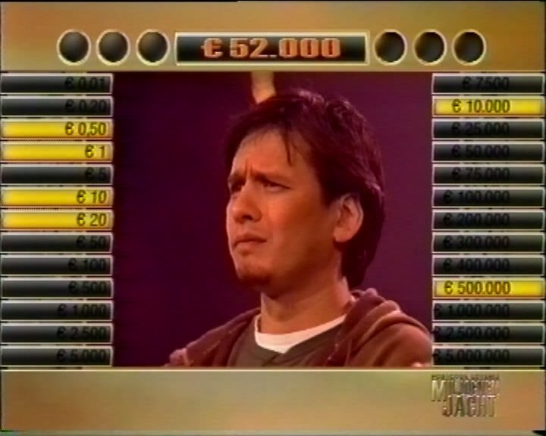
NO DEAL!
What would YOU do?
Mean = 85,005
Source: Post, et. al (2008)

Slide 12
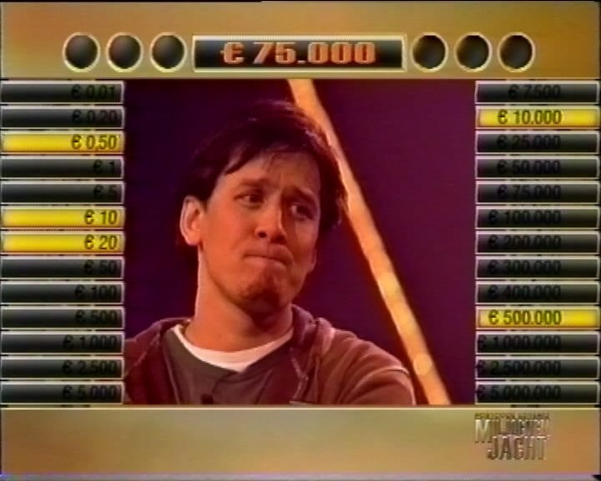
NO DEAL!
What would YOU do?
Mean = 102,006
Source: Post, et. al (2008)

Slide 13
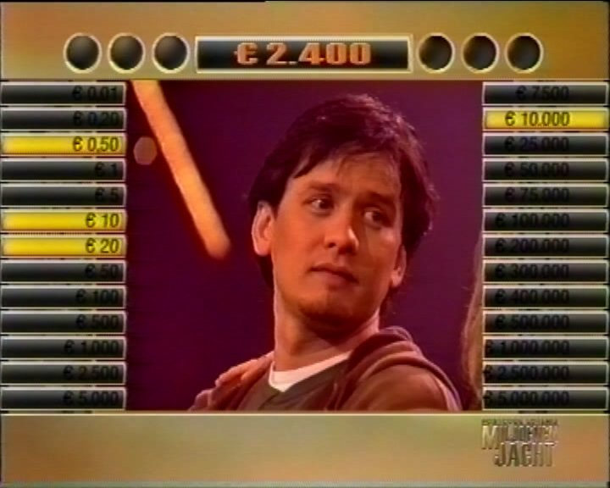
NO DEAL!
What would YOU do?
Mean = 2,508
Source: Post, et. al (2008)

Slide 14
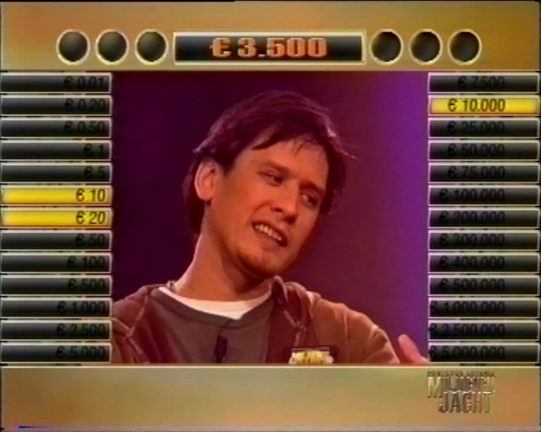
NO DEAL!
What would YOU do?
Mean = 3,343
Source: Post, et. al (2008)

Slide 15
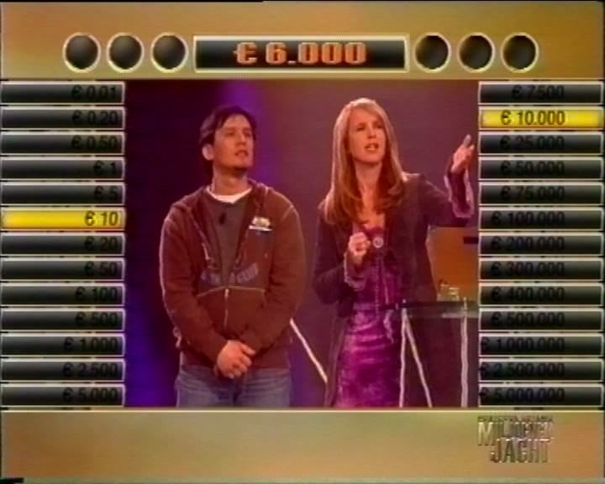
NO DEAL!
What would YOU do?
Mean = 5,005
Source: Post, et. al (2008)

Slide 16
Deal or No Deal?
Why did Frank play they way he did?

Slide 17
Prospect Theory – Value Function
VALUE
PLEASURE
LOSSES
GAINS
PAIN
REFERENCE POINT
Source: Kahneman and Tversky (1979, 1991)

Slide 18
Question:
Which of these two people is happier right now?
Judy has $1,000,000 in her 401(k) and lost $100 bill
Dave has $100,000 in his 401(k) and found $100 bill

Slide 19
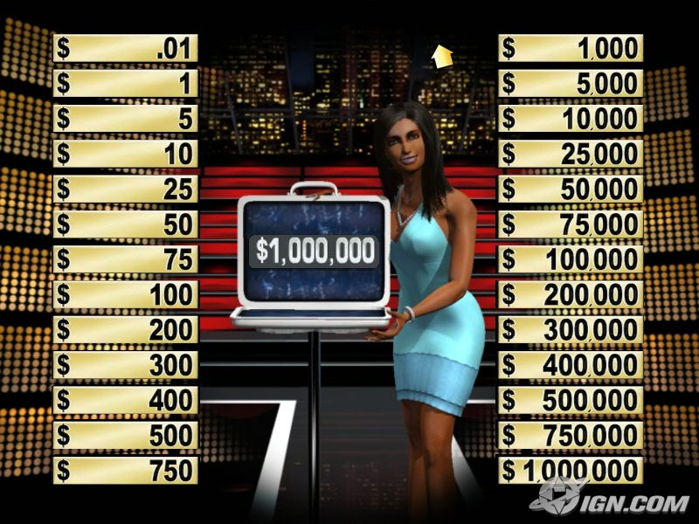
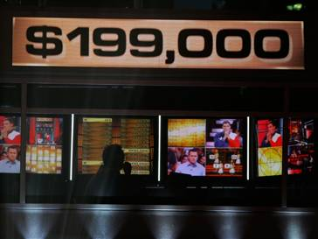
Deal or No Deal Reference Point
The Deal or No Deal player makes decisions based on a reference point:
The $1,000,000 Case?
The banker’s offer?
$0 (Everything is a gain)?

Slide 20
Prospect Theory Recap
Reference Point
Decisions are made based on the reference point, which can change with time

Slide 21
Question:
Consider the following bet: I flip a coin –either you win $200 or you lose $100. Are you willing to play it for real money right now?
Source: Samuelson (1969)

Slide 22
Why Do People Reject The Bet?
Samuelson’s bet is a great investment, since you “invest” $100 and you either lose it or get $300 back.
There is really no “risk” in losing $100 (other than looking foolish in front of the class).
Yet, most people reject the bet. Why?

Slide 23
Loss Aversion
Losses loom larger than gains
The pain of a loss is twice as great as the pleasure of a gain
We simply hate to lose – even small amounts

Slide 24
Prospect Theory Recap
Reference Point
Loss Aversion
The pain of a loss is greater than the pleasure of an equal gain

Slide 25
Question:
You purchase a stock at $32 and it is now selling at $40. In the next period, it is equally likely that it will increase or decrease by $10. Would you:
Sell and realize an $8 gain OR
Hold on for a 50/50 shot at another gain or a loss?

Slide 26
Question:
You purchased stock for $50 and it is now selling at $40. In the next period, it is equally likely that it will increase or decrease by $10. Would you:
(A) Sell and realize a $10 loss? OR
(B) Hold on for a 50/50 shot at another loss or breaking even?

Slide 27
Stock Performance
Why does the historical performance of the stock affect your decision?

Slide 28
Break Even Effect
Losers become more willing to take on risk in an attempt to break even
On Deal or No Deal, 56% reject any given “deal”
After bad fortune, rejection increases to 79%
Source: Post, et. al (2008)

Slide 29
Prospect Theory Continued
VALUE
RISK AVERSE
LOSSES
GAINS
RISK SEEKING
Source: Kahneman and Tversky (1979, 1991)

Slide 30
Prospect Theory Recap
Reference Point
Loss Aversion
Break Even Effect
When experiencing losses, people tend to exhibit risk seeking behavior to “break even”

Slide 31
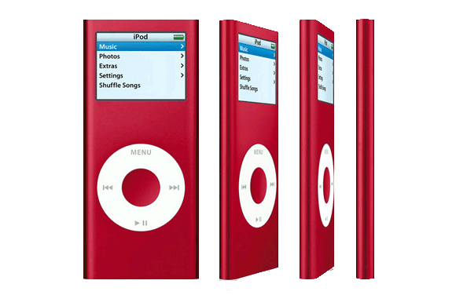
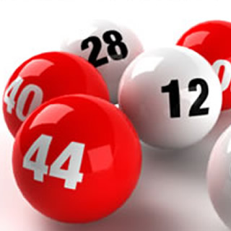
Prospect Theory – Weighting Function
I-Pod Extended Warranty
The Lottery
Source: Kahneman and Tversky (1979, 1991)

Slide 32
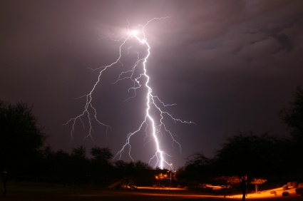
Weighting Extremes
You are less likely to win a lottery than to die by:
Source: http://saneok.org/files/Facts&Stats/LottoFacts.pdf

Slide 33
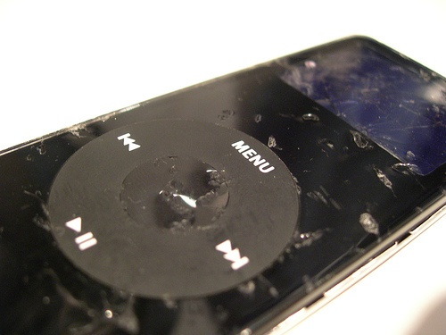
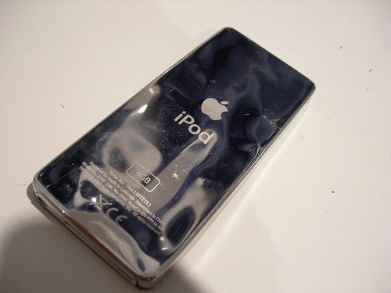
Weighting Extremes
Most iPods don’t fail within warranty period
Would you really want to use the warranty after 3 years – why not get a new iPod?

Slide 34
Prospect Theory Recap
Reference Point
Loss Aversion
Break Even Effect
Overweighting Small Probabilities
I can win the lottery!
Underweighting Large Probabilities
Almost guarantee is not enough!
Prospect Theory has even broader implications…

Slide 35
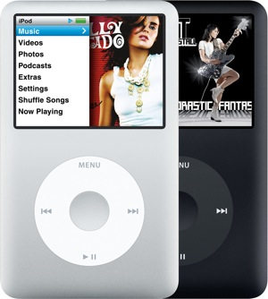
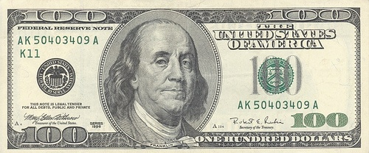
The Endowment Effect
People often demand much more to give up an item than they would pay to acquire it
When asked to choose between an iPod and $100, subjects were more likely to choose $100
When given an iPod and asked to trade for $100, most turned down the offer
Source: http://www.livescience.com/health/080701-saving-stuff.html

Slide 36
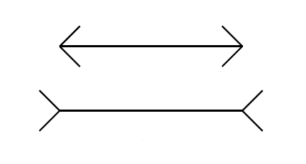
Which Line is Longer?
The way in which things are framed can influence judgment.
Source: http://www.turtletrader.com/heuristics.pdf

Slide 37
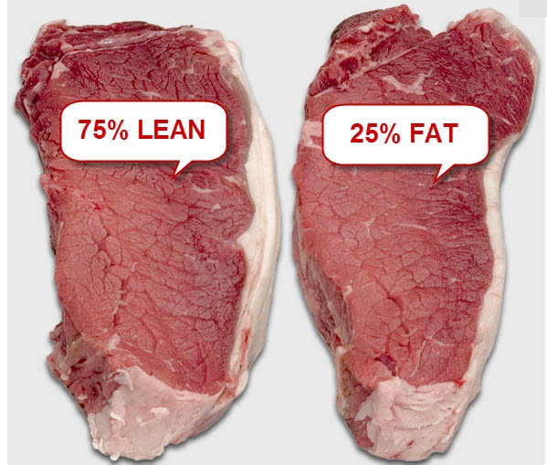
Which Steak is More Appealing?
Source: Levin and Gaeth (1988)

Slide 38
Reframing Retirement
75% Rule
How much of
current spending
you will maintain
in retirement
Exercise One
Write down three expenditures you will maintain in retirement.
______________________
______________________
______________________

Slide 39
Reframing Retirement
25% Rule
How much of
current spending
you will eliminate
in retirement
Exercise Two
Write down three expenditures you will eliminate in retirement.
______________________
______________________
______________________

Slide 40
Prospect Theory Recap
Reference Point
Loss Aversion
Break Even Effect
Overweighting Small Probabilities
Underweighting Large Probabilities
Endowment Effect
Framing
And Next Class…

Slide 41
Sum These Numbers OUT LOUD:
1000
10
1000
20
1000
30
1000
40
Is it 5000….
…or 4100?
Sometimes, heuristics can lead to the wrong answer!

