Slide 1
Common Cents
Sasha Ban, Ali Kermani, Erin Poulson, Dan Shaffer

Slide 2
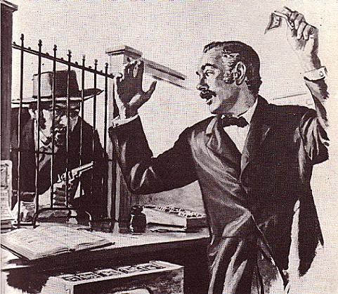
Problem with the Status Quo
Parents are not getting anything for their money
Children are learning poor financial behavior
Credit Card companies prey on young adults

Slide 3
Our Solution: Common Cents
3rd party intermediary service between parents & children
Debit account
Financial (or other) education service
Flexible test & withdraw schedule for students

Slide 4
How Common Cents works:
Step 1: Parent opens account for child with some amount of money
Step 2: Common Cents issues child a debit card linked to their Common Cents account
Step 3: Child logs onto their Common Cents account via our website & complete lesson plans to release funds onto debit card
Step 4: Parent & child can track spending habits, view test results, & learn responsible financial behavior

Slide 5
Show Me the Money
Initially we will offer the service for free and make our money on the float (interest on the unclaimed money we’re holding)
Once sufficient demand exists, we may opt to charge a low percentage as a service fee

Slide 6
Behavioral Principles
Suboptimal spending behaviors
Falling victim to heuristics & biases in spending decisions
People spend too much & borrow too much
Downfalls of credit card spending
Permanent income hypothesis (people spend what they expect they will eventually have)
Help temper the urge for immediate gratification, mental accounting, lack of budgeting, and innumeracy that draws many people into debt
Goal: transfer financial decision making from the intuitive to the deliberative self
Notes:
People tend to spend exactly what they earn

Slide 7
QUE$TION$?

Slide 8
Behavioral Principles
Anchoring *****by letting them know how little money they are getting***
Inertia?
For the parents, to customize – choice overload
Ease of evaluation
Familiarity bias … debit card style?

Slide 9
Intuitive vs. Deliberative Self
Cognitive / Deliberative
Relatively slow
Demanding of cognitive capacity
Controlled
Analytic
Rule-based
 | Intuitive / Affective
 | Relatively fast
 | Undemanding of cognitive capacity
 | Automatic
 | Holistic
 | Associative
Sources: Stanovich and West (2002)

Slide 10
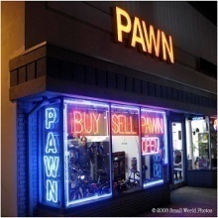
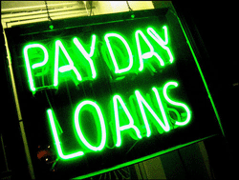
Debt Aversion
Average 4 yr student loan debt is only $16,700
26% of low income students and 31% of Asians don’t even apply
Some people tend to pay off low rate loans faster than required, even when there are better investment opportunities available
Sources: Burdman (2005), Cadena, et al (2006)

Slide 11
Excessive Debt
Debt / income ratio closely linked with anxiety
Average credit card debt increased 300% (in households with at least one card) between 1990 and 2002
WHY?
Sources: Dretna (2000), Money Central at www.msn.com

